Slide 1
Lecture 4 Shape of distribution and Measures of Central Tendency

Slide 2
Review From Friday 1/19
3 features of a distribution that we are interested in:
Shape
Center
Spread or variability
Graphs of data are a good way summarize patterns in data
Graphs for qualitative data are
Bar graphs, pie charts
Graphs for quantitative data are:
Stem plot, dot plot, histogram

Slide 3

Practice: Histogram
$X=\{−1.49, −0.65, −0.6, −0.54, −0.45, 0.01, 0.17, 0.27, 0.51, 1.34\}$
Construct a histogram using K = 4 bins/intervals:

Slide 4
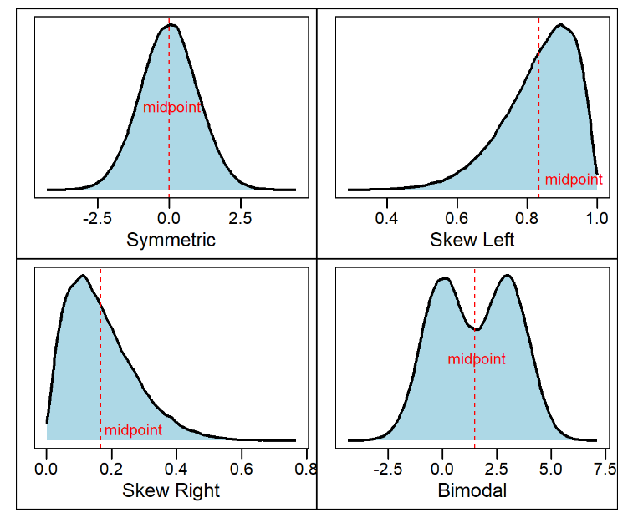
Shape of a distribution

Slide 5
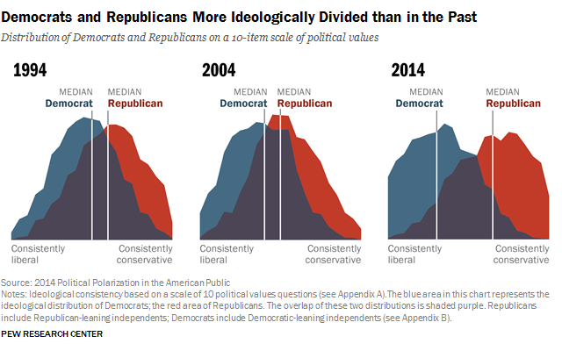
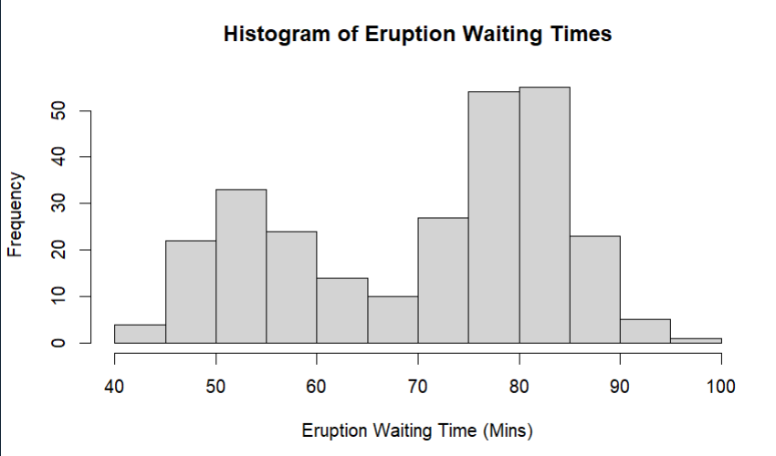
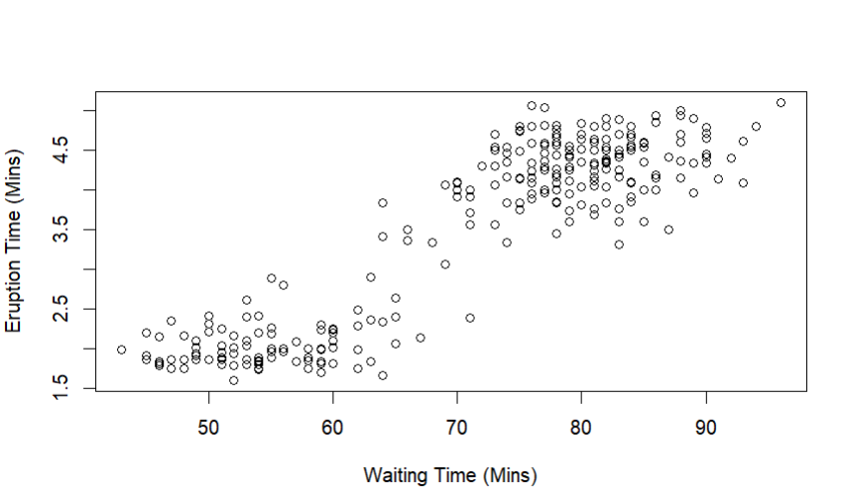
Bimodal distributions can arise when
- A population is polarized on a controversial issue
- When observations come from two different sub-populations

Slide 6
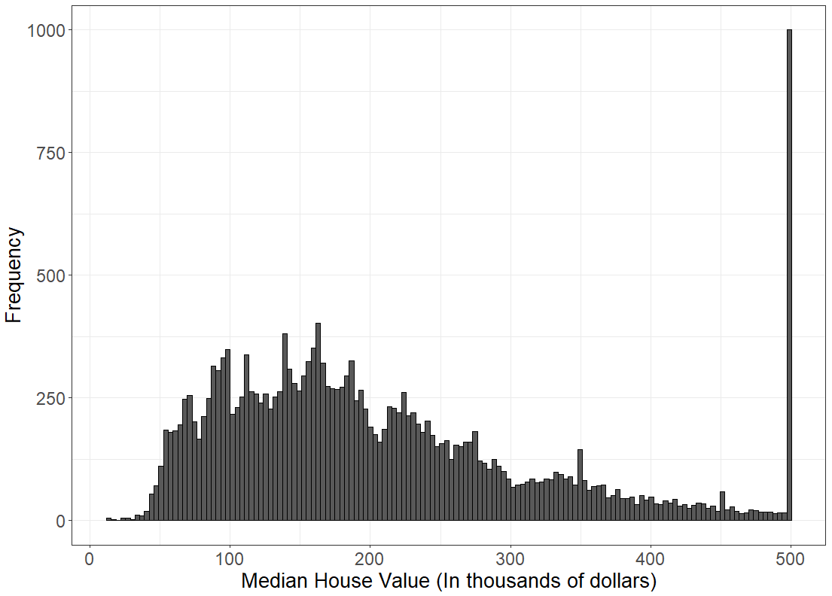
Consider the following histogram of median housing prices in California from the 1990 national census
Skewed distributions occur when there is a strict boundary on the possible values of a variable

Slide 7
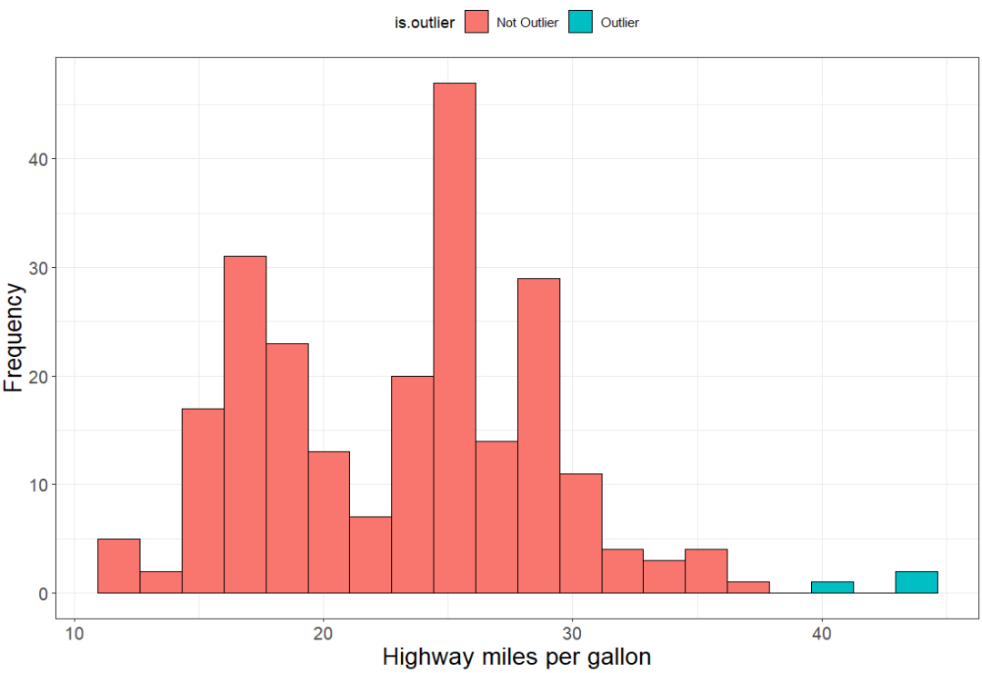
Outliers are extreme values that fall far away from the midpoint of the data
Consider the following histogram of the fuel efficiency of cars from 1990 - 2008

Slide 8
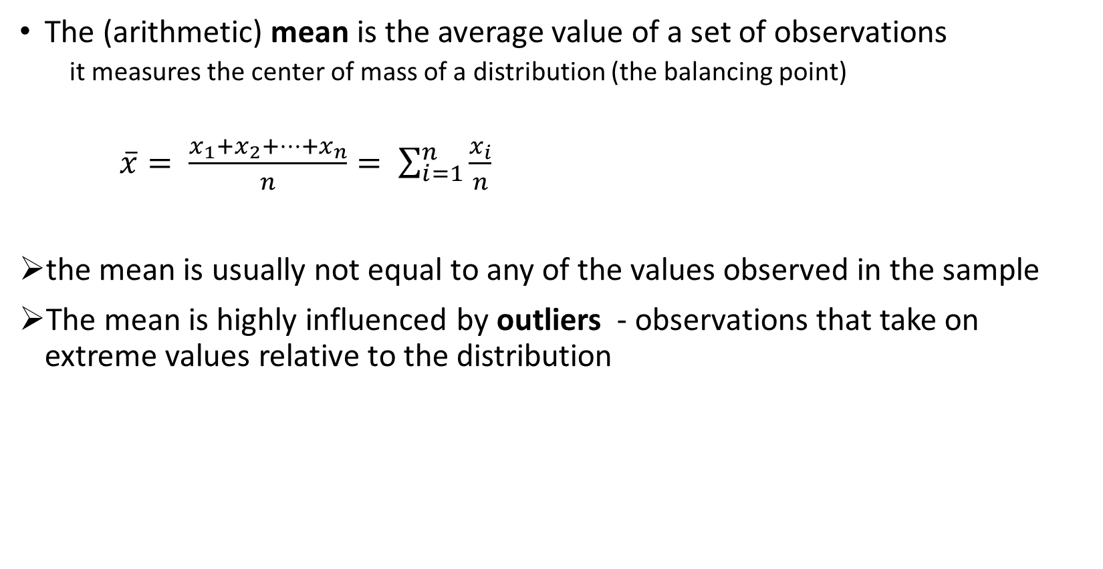
Measures of Central Tendency
The (arithmetic) mean is the average value of a set of observations
it measures the center of mass of a distribution (the balancing point)
$\overline{x}= \frac{x_{1}+x_{2}+…+x_{n}}{n}= \sum_{i=1}^{n}{\frac{x_{i}}{n}}$
the mean is usually not equal to any of the values observed in the sample
The mean is highly influenced by outliers - observations that take on extreme values relative to the distribution

Slide 9

Practice: Calculate The Mean
$X=\{1, 3, 5, 5, 6, 7, 7, 8\}$

Slide 10
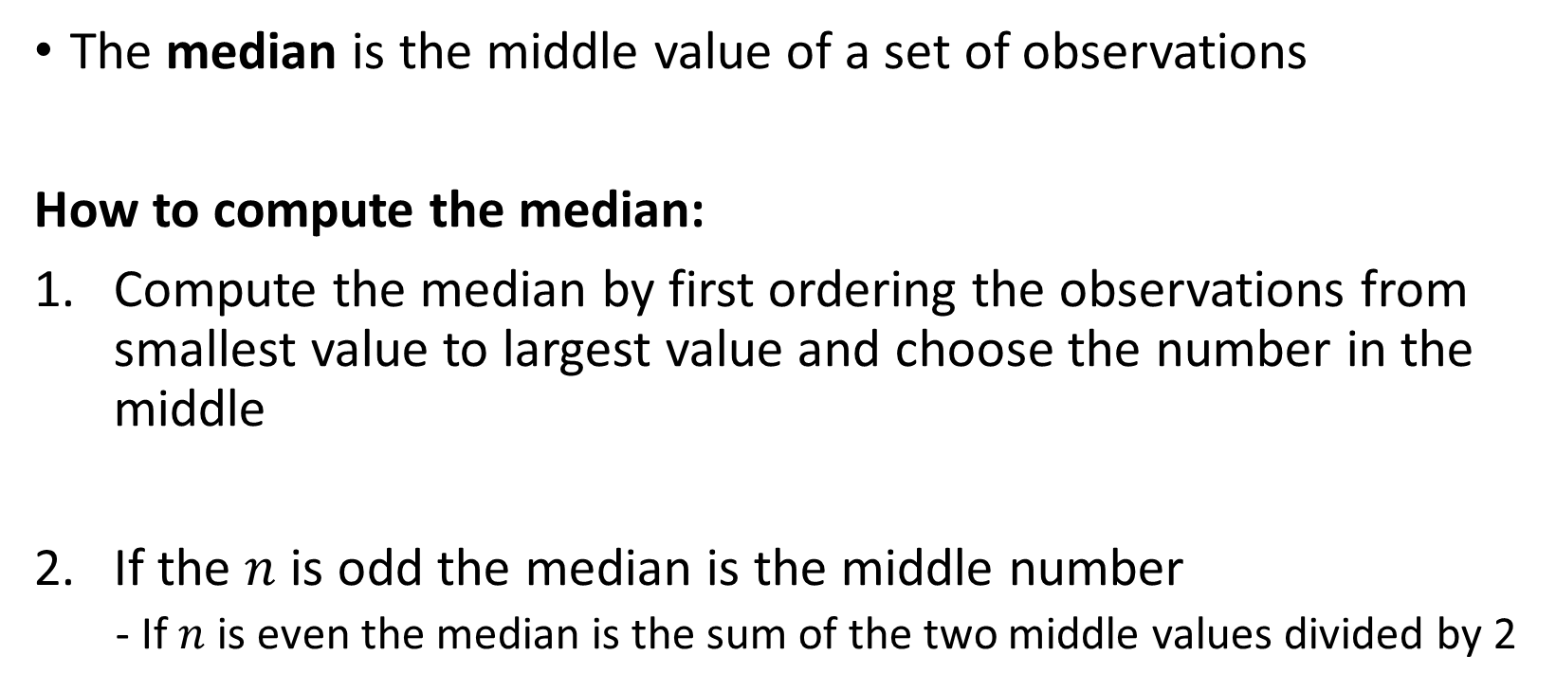
Measures of Central Tendency
The median is the middle value of a set of observations
How to compute the median:
Compute the median by first ordering the observations from smallest value to largest value and choose the number in the middle
If the $n$ is odd the median is the middle number
- If $n$ is even the median is the sum of the two middle values divided by 2

Slide 11

Practice: Calculate the Median
$X=\{1, 3, 5, 5, 6, 7, 7, 8\}$

Slide 12
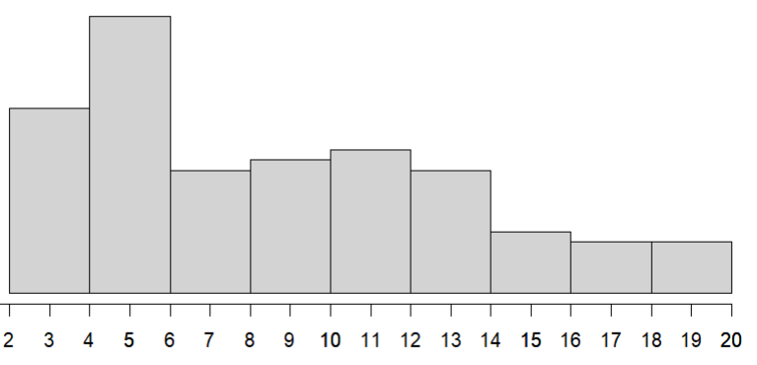


Data: 3 3 3 3 3 3 3 4 4 4 4 4 4 4 4 4 4 5 5 5 5 5 5 5 5 5 5
5 5 5 5 5 5 5 5 5 6 6 6 6 6 6 6 6 6 6 7 7 7 7 7 7 7 7
7 8 8 8 8 8 8 9 9 9 9 9 9 9 10 10 10 10 10 10 10 11 11 11 11 11 12
12 12 12 12 12 12 12 13 13 13 14 14 14 14 14 14 15 15 15 16 16 16 16 17 17 17 18
18 20 20 20 20 20
$$\overline{x}=9.2$$
$$median=\frac{8+8}{2}=8$$
The mean is the center of gravity
The median is the middle value

Slide 13

Mean and median treat outliers differently
$X=\{1, 3, 5, 5, 6, 7, 7, 8, 32\}$

Slide 14
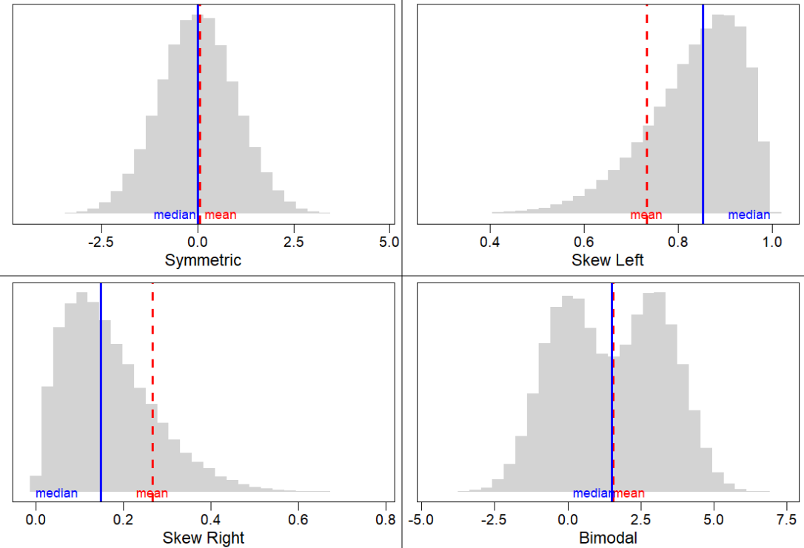

Slide 15
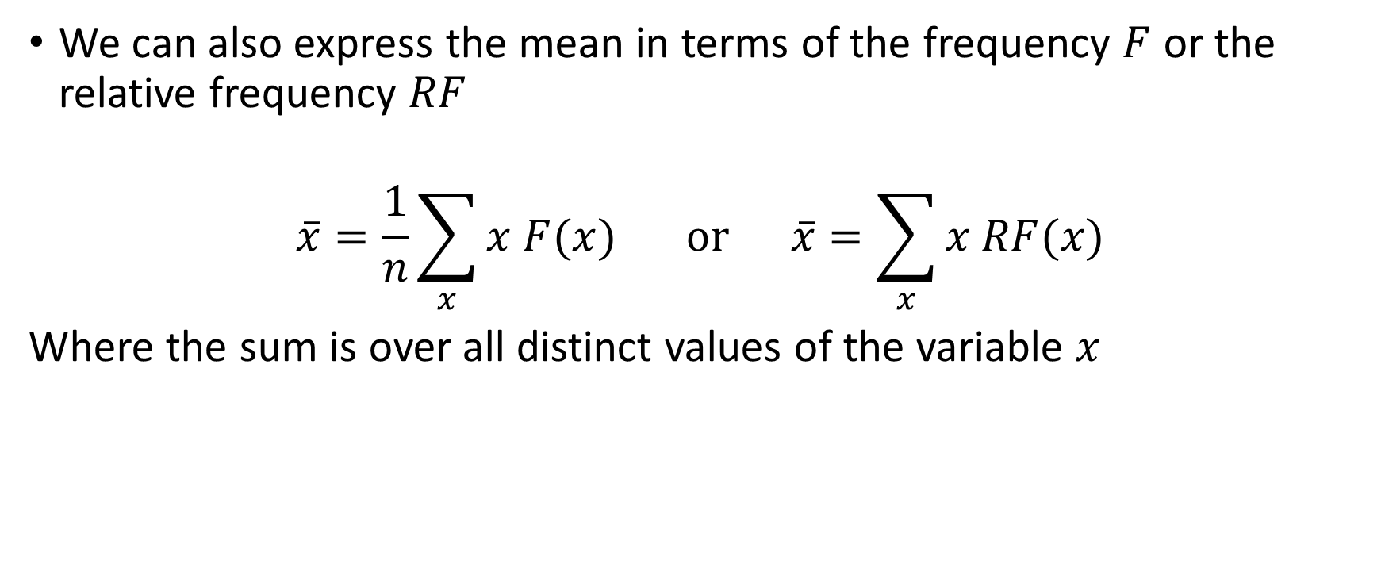
Alternative formulas for the mean
We can also express the mean in terms of the frequency $F$ or the relative frequency $RF$
$$\overline{x}=\frac{1}{n}\sum_{x}{x F(x)} or \overline{x}=\sum_{x}{x RF(x)}$$
Where the sum is over all distinct values of the variable $x$

Slide 16
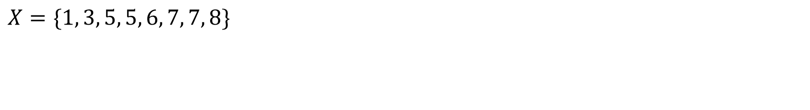
Example: Computing the mean from a frequency table
X | Freq. | Rel. Freq
1 | 1 | 0.125
3 | 1 | 0.125
5 | 2 | 0.250
6 | 6 | 0.125
7 | 2 | 0.250
8 | 1 | 0.125
$$X=\{1, 3, 5, 5, 6, 7, 7, 8\}$$

Slide 17
The mode
The mode is the value with the largest relative frequency (i.e the value that occurs most often)
Can be used with categorical data (mean and median cannot)
- e.g the most frequent category
It may not be unique if two or more values have the same frequency
Caution for quantitative data, the mode may not anywhere near the center of the distribution.
Ex.)
Data = 1,1,4,5,6
Mode = 1
Data = 1,1,4,5,6,6
Mode 1, 6

Slide 18
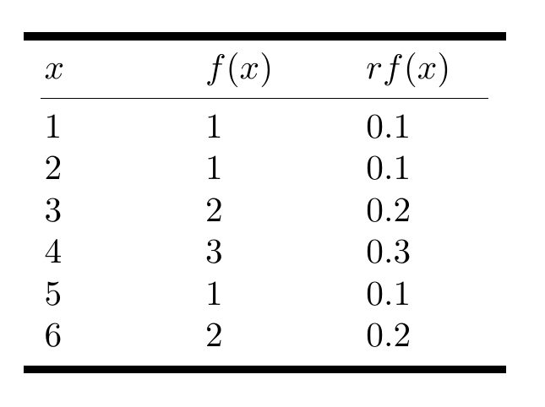
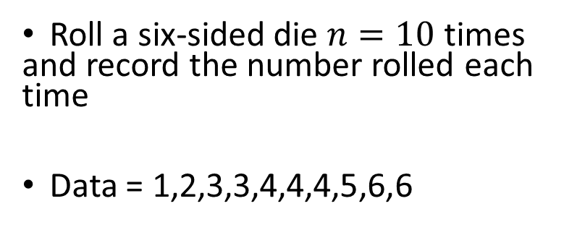
Practice:
Roll a six-sided die $n=10$ times and record the number rolled each time
Data = 1,2,3,3,4,4,4,5,6,6
Compute the mean using all 3 equations:
Compute the median
Compute the mode

Slide 19
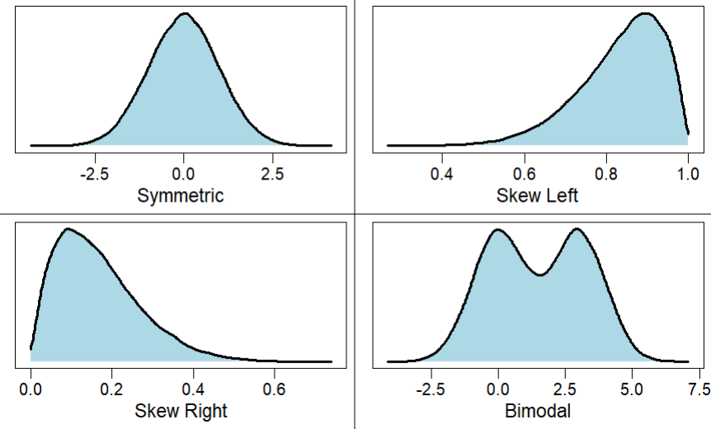
Comparing the Mean, Median, and Mode
The shape of a distribution influences whether the mean is larger or smaller.
Skew left = mean < median
Skew right = mean > median
When a distribution is symmetric the mean will equal the median

Slide 20
Comparing the Mean, Median, and Mode
The median is a robust estimate of the mean
The median is not usually affected by the presence of outliers
The median is usually preferred for highly skewed distributions
Ex.) take using the following 9 data points: 0.3, 0.4, 0.8, 1.4, 1.8, 2.1, 5.9, 11.6, 16.9
The mean is about 4.58
The median is 1.8
Change one of the data points to be an outlier, for example, we change 16.9 to 90
The mean becomes 12.7
While the median is still 1.8

Slide 21
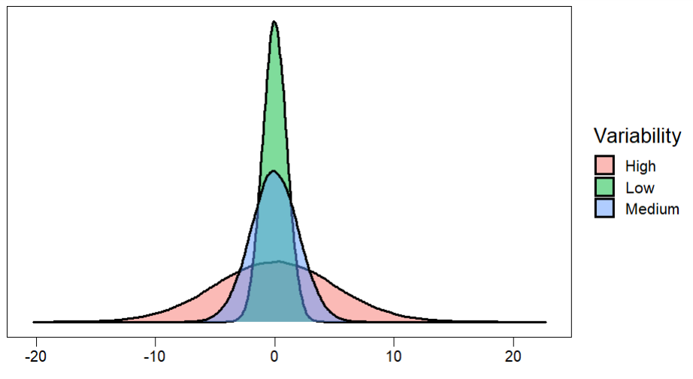
Variability of A Distribution: Measures of Spread

Slide 22
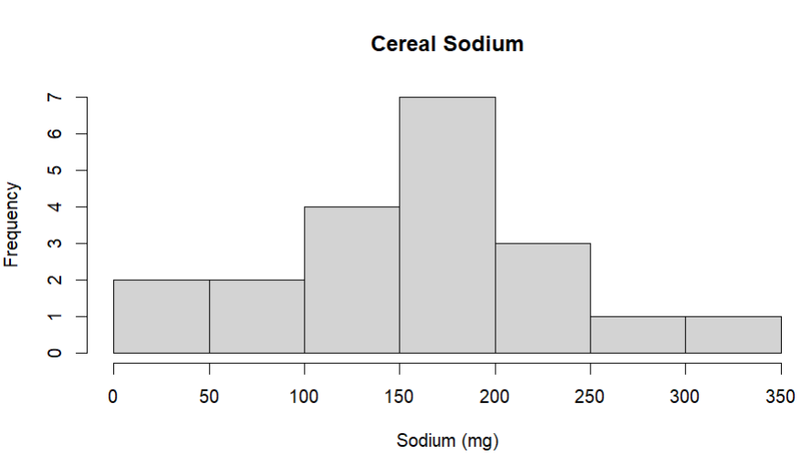
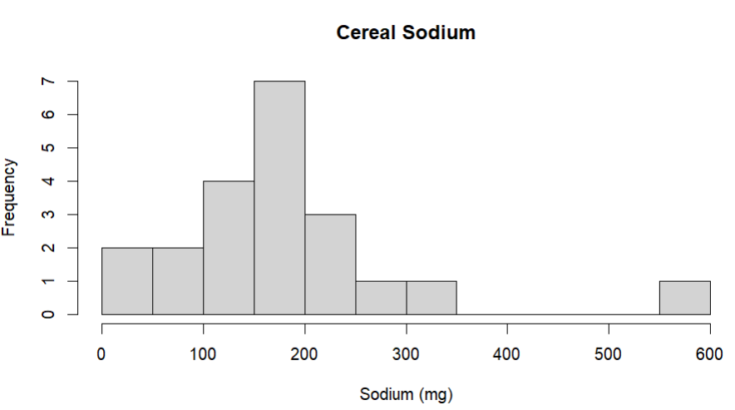
Measures of Spread: Range
The range is a measure of the distance between the smallest and largest values in the data
The range can be computed with only two data points the minimum value and maximum value
If the range of a set of data is large, then the data vary more
The range is severely affected by the presence of outliers
We typically do not use the range to measure variability

Slide 23
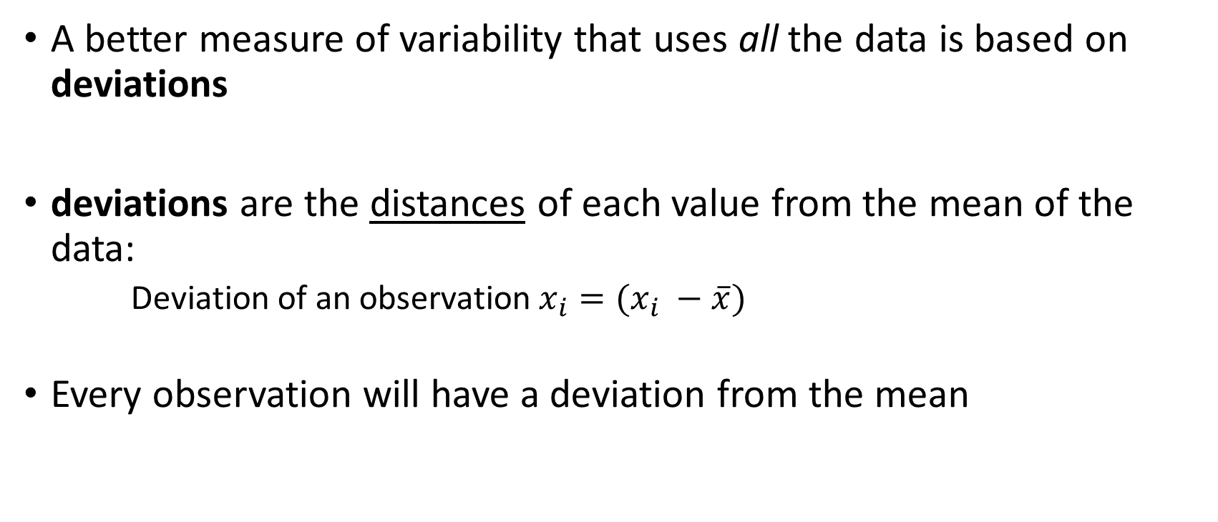
Measures of Spread: Deviation
A better measure of variability that uses all the data is based on deviations
deviations are the distances of each value from the mean of the data:
Deviation of an observation$x_{i}=(x_{i} −\overline{x})$
Every observation will have a deviation from the mean

Slide 24
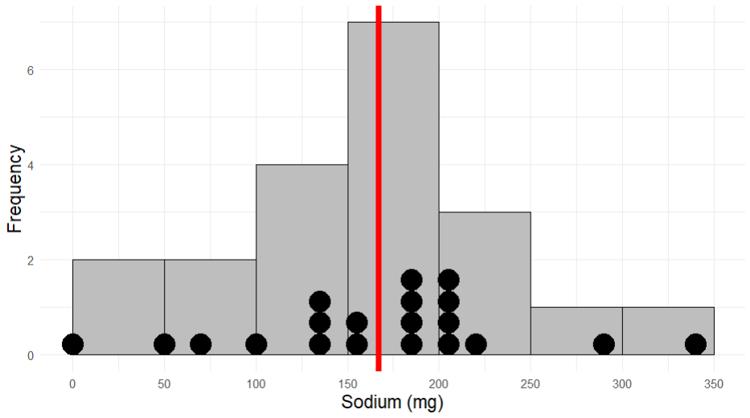


Frosted Mini Wheats = 0 (mg)
Mean = 167 (mg)
Rice Krispes = 340 (mg)
$$0 −167=−167$$
$$340 −167=173$$

Slide 25
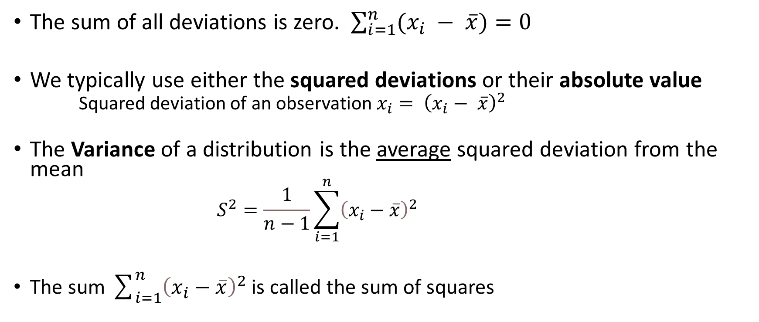
Measures of Spread: Variance
The sum of all deviations is zero. $\sum_{i=1}^{n}{(x_{i} − \overline{x})}=0$
We typically use either the squared deviations or their absolute value
Squared deviation of an observation $x_{i}= {\left(x_{i}− \overline{x}\right)}^{2}$
The Variance of a distribution is the average squared deviation from the mean
$$S^{2}=\frac{1}{n−1}\sum_{i=1}^{n}{{\left(x_{i}−\overline{x}\right)}^{2}}$$
The sum $\sum_{i=1}^{n}{{\left(x_{i}−\overline{x}\right)}^{2}}$ is called the sum of squares

Slide 26
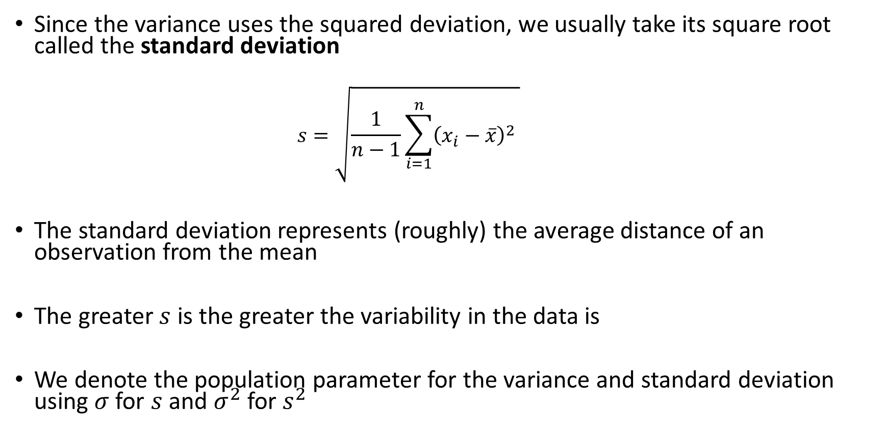
Measures of Spread: Standard Deviation
Since the variance uses the squared deviation, we usually take its square root called the standard deviation
$$s=\sqrt{\frac{1}{n−1}\sum_{i=1}^{n}{{\left(x_{i}−\overline{x}\right)}^{2}} }$$
The standard deviation represents (roughly) the average distance of an observation from the mean
The greater $s$ is the greater the variability in the data is
We denote the population parameter for the variance and standard deviation using $σ$ for $s$ and $σ^{2}$ for $s^{2}$

Slide 27
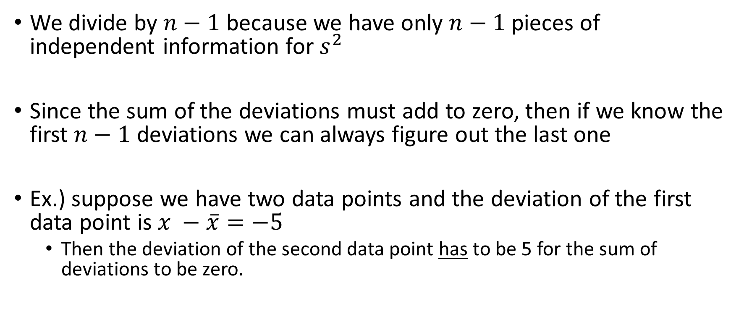
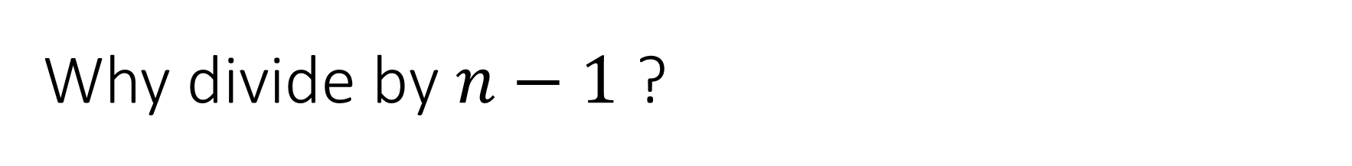
Why divide by $n−1$ ?
We divide by $n−1$ because we have only $n−1$pieces of independent information for $s^{2}$
Since the sum of the deviations must add to zero, then if we know the first $n−1$ deviations we can always figure out the last one
Ex.) suppose we have two data points and the deviation of the first data point is $x −\overline{x}=−5$
Then the deviation of the second data point has to be 5 for the sum of deviations to be zero.

Slide 28
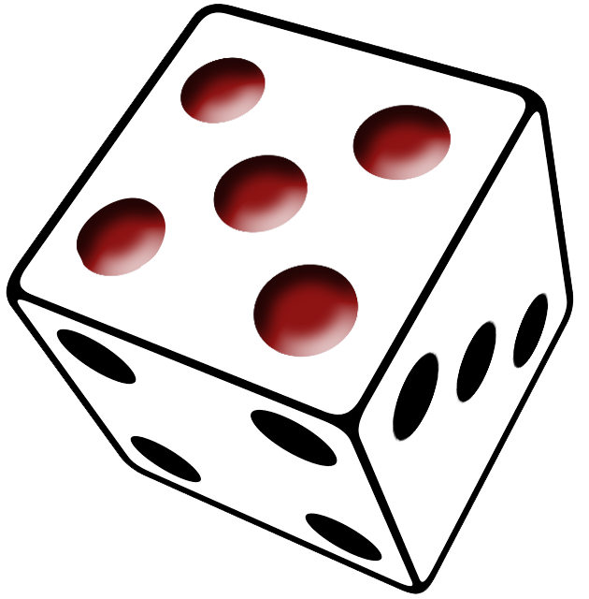

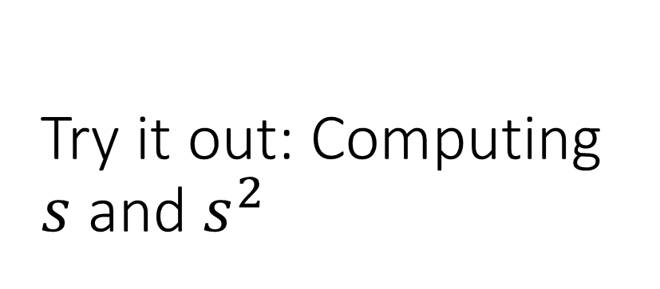
Try it out: Computing $s$ and $s^{2}$
Roll a six-sided die $n=10$ times and record the number rolled each time
Data = 1,2,3,3,4,4,4,5,6,6
Mean = 3.8

